Slide 1
Module 2: Smart Objects: The “Things” in IOT
A sensor senses. More specifically, a sensor measures some physical quantity and converts that measurement reading into a digital representation.
That digital representation is typically passed to another device for transformation into useful data that can be consumed by intelligent devices or humans.
Sensors provide super human sensory capabilities
Sensors can be readily embedded in any physical objects that are easily connected to the internet by wired or wireless networks.

Slide 2
Module 2: Smart Objects: The “Things” in IOT
A There are a number of ways to group and cluster sensors into different categories, they are:
Active or passive
Invasive or non-invasive
Contact or no-contact
Absolute or relative
Area of application
How sensors measure
What sensors measure

Slide 3
Module 2: Smart Objects: The “Things” in IOT
Active or passive:
Sensors can be categorized based on whether they produce an energy output and typically require an external power supply (active) or whether they simply receive energy and typically require no external power supply (passive).
Invasive or non-invasive:
Sensors can be categorized based on whether a sensor is part of the environment it is measuring (invasive) or external to it (non-invasive).
Contact or no-contact:
Sensors can be categorized based on whether they require physical contact with what they are measuring (contact) or not (no-contact).

Slide 4
Module 2: Smart Objects: The “Things” in IOT
Absolute or relative:
Sensors can be categorized based on whether they measure on an absolute scale (absolute) or based on a difference with a fixed or variable reference value (relative).
Area of application:
Sensors can be categorized based on the specific industry or vertical where they are being used.
How sensors measure:
Sensors can be categorized based on the physical mechanism used to measure sensory input (for example, thermoelectric, electrochemical, piezoresistive, optic, electric, fluid mechanic, photoelastic).
What sensors measure:
Sensors can be categorized based on their applications or what physical variables they measure.

Slide 5
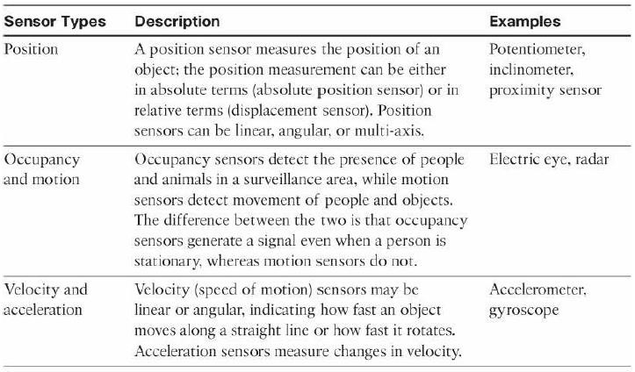
Module 2: Smart Objects: The “Things” in IOT
Categorization of sensors based on what physical phenomenon a sensor is measuring:

Slide 6
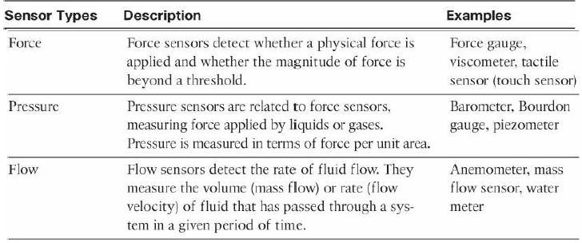
Module 2: Smart Objects: The “Things” in IOT
Categorization of sensors based on what physical phenomenon a sensor is measuring:

Slide 7
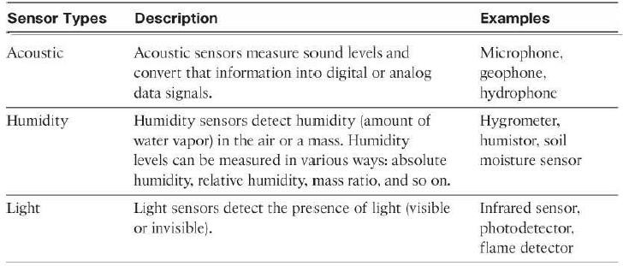
Module 2: Smart Objects: The “Things” in IOT
Categorization of sensors based on what physical phenomenon a sensor is measuring:

Slide 8
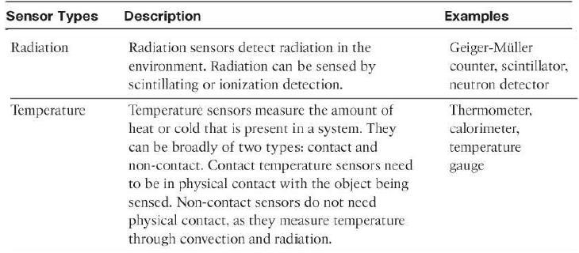
Module 2: Smart Objects: The “Things” in IOT
Categorization of sensors based on what physical phenomenon a sensor is measuring:

Slide 9
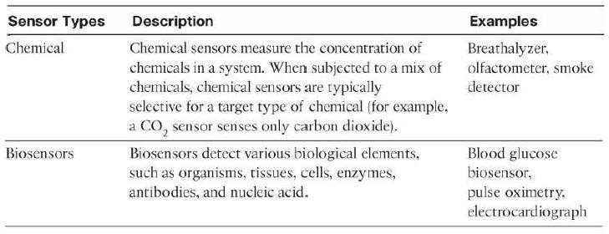
Module 2: Smart Objects: The “Things” in IOT
Categorization of sensors based on what physical phenomenon a sensor is measuring:

Slide 10
Module 2: Smart Objects: The “Things” in IOT
Sensors:
Sensors come in all shapes and sizes and can measure all types of physical conditions.
A fascinating use case to highlight the power of sensors and IoT is in the area of precision agriculture (sometimes referred to as smart farming), which uses a variety of technical advances to improve the efficiency, sustainability, and profitability of traditional farming practices.
This includes the use of GPS and satellite aerial imagery for determining field viability; robots for high-precision planting, harvesting, irrigation, and so on; and real-time analytics and artificial intelligence to predict optimal crop yield, weather impacts, and soil quality.
The most significant impacts of precision agriculture are those dealing with sensor measurement of a variety of soil characteristics.

Slide 11
Module 2: Smart Objects: The “Things” in IOT
Sensors:
These include real-time measurement of soil quality, pH levels, salinity, toxicity levels, moisture levels for irrigation planning, nutrient levels for fertilization planning.
All this detailed sensor data can be analyzed to provide highly valuable and actionable insight to boost productivity and crop yield.
Figure shows biodegradable, passive microsensors to measure soil and crop and conditions.
These sensors, developed at North Dakota State University (NDSU), can be planted directly in the soil and left in the ground to biodegrade without any harm to soil quality.

Slide 12
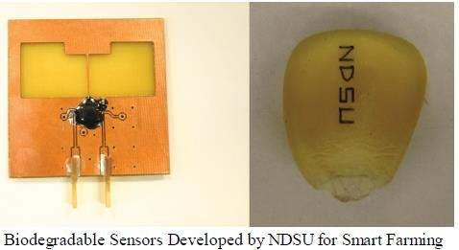
Module 2: Smart Objects: The “Things” in IOT

Slide 13
Module 2: Smart Objects: The “Things” in IOT
Sensors:
IoT and by extension, networked sensors have been repeatedly named among a small number of emerging revolutionary technologies that will change the global economy and shape the future.
The astounding volume of sensors is in large part due to their smaller size, their form factor, and their decreasing cost.
These factors make possible the economic and technical feasibility of having an increased density of sensors in objects of all types.
Most significant accelerator for sensor deployments is mobile phones.
More than a billion smart phones are sold each year, and each one has well over a dozen sensors inside it.

Slide 14
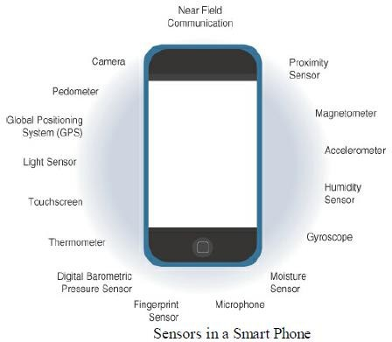
Module 2: Smart Objects: The “Things” in IOT
Sensors:

Slide 15
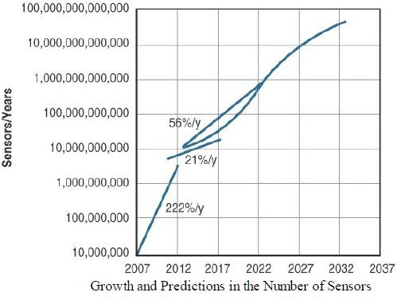
Module 2: Smart Objects: The “Things” in IOT
Sensors:

Slide 16
Module 2: Smart Objects: The “Things” in IOT
ACTUATOR
An actuator is a component of a machine or system that moves or controls the mechanism or the system.
An actuator is the mechanism by which a control system acts upon an environment
An actuator requires a control signal and a source of energy.
Actuators are natural complements to sensors.
Figure demonstrates the symmetry and complementary nature of these two types of devices.
Sensors are designed to sense and measure practically any measurable variable in the physical world.
They convert their measurements (typically analog) into electric signals or digital representations that can be consumed by an intelligent agent (a device or a human).
Actuators, receive some type of control signal (commonly an electric signal or digital command) that triggers a physical effect, usually some type of motion, force, and so on.

Slide 17
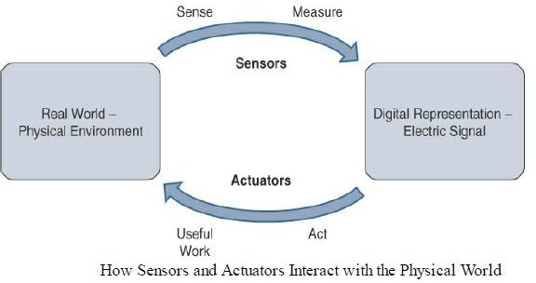
Module 2: Smart Objects: The “Things” in IOT
ACTUATOR

Slide 18
Module 2: Smart Objects: The “Things” in IOT
ACTUATOR
IoT sensors are devices that sense and measure the physical world and (typically) signal their measurements as electric signals sent to some type of microprocessor or microcontroller for additional processing.
Correspondingly, a processor can send an electric signal to an actuator that translates the signal into some type of movement (linear, rotational, and so on) or useful work that changes or has a measurable impact on the physical world.
This interaction between sensors, actuators, and processors and the similar functionality in biological systems is the basis for various technical fields, including robotics and biometrics.

Slide 19
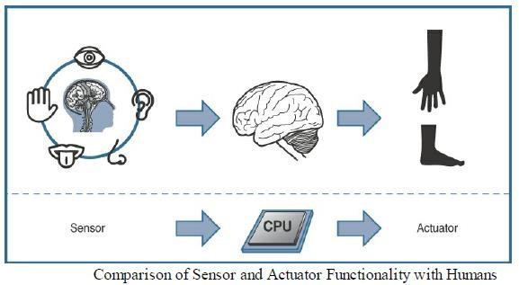
Module 2: Smart Objects: The “Things” in IOT
ACTUATOR

Slide 20
Module 2: Smart Objects: The “Things” in IOT
ACTUATOR
Actuators vary greatly in function, size, design, and so on.
Some common ways that they can be classified include the following:
Type of motion
Power
Binary or continuous
Area of application
Type of energy

Slide 21
Module 2: Smart Objects: The “Things” in IOT
ACTUATOR
Type of motion: Actuators can be classified based on the type of motion they produce (for example, linear, rotary, one/two/three-axes).
Power: Actuators can be classified based on their power output (for example, high power, low power, micro power)
Binary or continuous: Actuators can be classified based on the number of stable-state outputs.
Area of application: Actuators can be classified based on the specific industry or vertical where they are used.
Type of energy: Actuators can be classified based on their energy type.

Slide 22
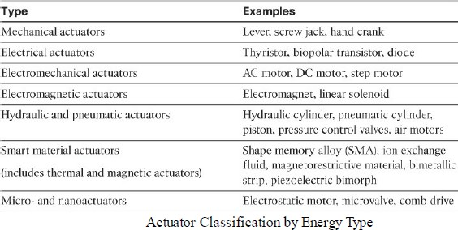
Module 2: Smart Objects: The “Things” in IOT
ACTUATOR
Table shows actuators classified by energy type and some examples for each type

Slide 23
Module 2: Smart Objects: The “Things” in IOT
ACTUATOR
Sensors provide the information, actuators provide the action.
The most interesting use cases for IoT are those where sensors and actuators work together in an intelligent.
For example, the smart sensors used to evaluate soil quality (by measuring a variety of soil, temperature, and plant characteristics) can be connected with electrically or pneumatically controlled valve actuators that control water, pesticides, fertilizers, herbicides, and so on.
Intelligently triggering a high-precision actuator based on well-defined sensor readings of temperature, pH, soil/air humidity, nutrient levels, and so on to deliver a highly optimized and custom environment-specific solution is truly smart farming.

Slide 24
Module 2: Smart Objects: The “Things” in IOT
Micro-Electro-Mechanical Systems (MEMS):
One of the most interesting advances in sensor and actuator technologies is in how they are packaged and deployed.
Micro-electro-mechanical systems (MEMS), sometimes simply referred to as micro-machines, can integrate and combine electric and mechanical elements, such as sensors and actuators, on a very small (millimeter or less) scale.
One of the keys to this technology is a microfabrication technique that is similar to what is used for microelectronic integrated circuits.
This approach allows mass production at very low costs.
The combination of tiny size, low cost, and the ability to mass produce makes MEMS an attractive option for a huge number of IoT applications.

Slide 25
Module 2: Smart Objects: The “Things” in IOT
Micro-Electro-Mechanical Systems (MEMS):
MEMS devices have already been widely used in a variety of different applications and can be found in very familiar everyday devices.
For example, inkjet printers use micro pump MEMS.
Smart phones also use MEMS technologies for things like accelerometers and gyroscopes.
Automobiles were among the first to commercially introduce MEMS into the mass market, with airbag accelerometers.

Slide 26
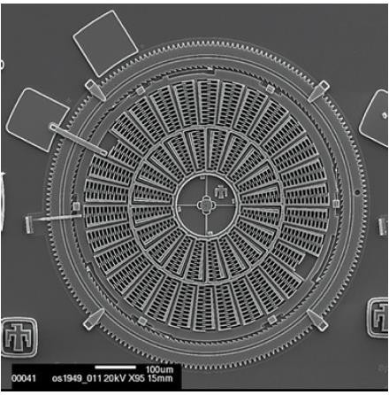
Module 2: Smart Objects: The “Things” in IOT
Micro-Electro-Mechanical Systems (MEMS):
Torsional ratcheting actuator (TRA) MEMS that was developed by Sandia National Laboratory as a low-voltage alternative to a micro-engine.
This MEMS is only a few hundred micrometers across; a scanning electron microscope is needed to show the level of detail visible in the figure.
Micro-scale sensors and actuators are immensely embeddable in everyday objects, which is a defining characteristic of IoT.

Slide 27
Module 2: Smart Objects: The “Things” in IOT
Smart Objects:
Smart objects are the building blocks of IoT.
They transform everyday objects into a network of intelligent objects that are able to learn from and interact with their environment in a meaningful way.
If soil sensor is connected as part of an intelligent network that is able to coordinate intelligently with actuators to trigger irrigation systems as needed based on those sensor readings, we have something far more powerful.
The coordinated sensor/actuator set is intelligently interconnected with other sensor/actuator sets to further coordinate fertilization, pest control, and so on—and even communicate with an intelligent backend to calculate crop yield potential.
The term smart object is often used interchangeably with terms such as smart sensor, smart device, IoT device, intelligent device, thing, smart thing, intelligent node, intelligent thing, ubiquitous thing, and intelligent product.

Slide 28
Module 2: Smart Objects: The “Things” in IOT
Smart Objects:
1. Processing unit:
A smart object has some type of processing unit for acquiring data, processing and analyzing sensing information received by the sensor(s), coordinating control signals to any actuators, and controlling a variety of functions on the smart object, including the communication and power systems.
The most common is a microcontroller because of its small form factor, flexibility, programming simplicity, low power consumption, and low cost.
2. Sensor(s) and/or actuator(s):
A smart object is capable of interacting with the physical world through sensors and actuators.
A sensor learns and measures its environment, whereas an actuator is able to produce some change in the physical world.
A smart object does not need to contain both sensors and actuators.
In fact, a smart object can contain one or multiple sensors and/or actuators, depending upon the application.

Slide 29
Module 2: Smart Objects: The “Things” in IOT
Smart Objects:
3. Communication device:
The communication unit is responsible for connecting a smart object with other smart objects and the outside world (via the network).
Communication devices for smart objects can be either wired or wireless.
In IoT networks smart objects are wirelessly interconnected for a number of reasons, including cost, limited infrastructure availability, and ease of deployment.
There are different communication protocols for smart objects.

Slide 30
Module 2: Smart Objects: The “Things” in IOT
Smart Objects:
4. Power source:
Smart objects have components that need to be powered.
Most significant power consumption comes from the communication unit of a smart object.
The power requirements vary greatly from application to application.
Smart objects are limited in power, are deployed for a very long time, and are not easily accessible.
This combination, when the smart object relies on battery power, implies that power efficiency, judicious power management, sleep modes, ultra-low power consumption hardware, and so on are critical design elements.

Slide 31
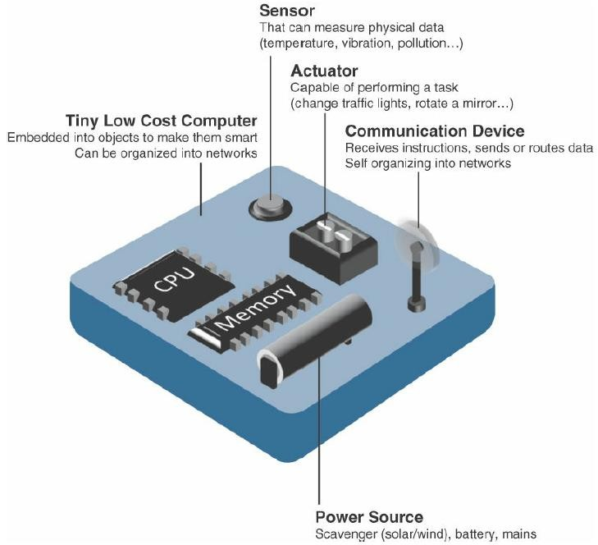
Module 2: Smart Objects: The “Things” in IOT

Slide 32
Module 2: Smart Objects: The “Things” in IOT
Trends in Smart Objects:
Broad generalizations and trends impacting IoT:
Size is decreasing
Power consumption is decreasing
Processing power is increasing
Communication capabilities are improving
Communication is being increasingly standardized

Slide 33
Module 2: Smart Objects: The “Things” in IOT
Size is decreasing:
In reference to MEMS, there is a clear trend of ever-decreasing size.
Some smart objects are so small they are not even visible to the naked eye.
This reduced size makes smart objects easier to embed in everyday objects.
Power consumption is decreasing:
The different hardware components of a smart object continually consume less power.
This is especially true for sensors, many of which are completely passive. Some battery powered sensors last 10 or more years without battery replacement.
Processing power is increasing:
Processors are continually getting more powerful and smaller.
This is a key advancement for smart objects, as they become increasingly complex and connected.

Slide 34
Module 2: Smart Objects: The “Things” in IOT
4. Communication capabilities are improving:
Wireless speeds are continually increasing, but they are also increasing in range.
IoT is driving the development of more and more specialized communication protocols covering a greater diversity of use cases and environments.
5. Communication is being increasingly standardized:
There is a strong push in the industry to develop open standards for IoT communication protocols.
In addition, there are more and more open source efforts to advance IoT.

Slide 35
Module 2: Smart Objects: The “Things” in IOT
Sensor Networks:
A sensor/actuator network (SANET), is a network of sensors that sense and measure their environment and/or actuators that act on their environment.
The sensors and/or actuators in a SANET are capable of communicating and cooperating in a productive manner.
Effective and well coordinated communication and cooperation is a prominent challenge, primarily because the sensors and actuators in SANETs are diverse, heterogeneous, and resource-constrained.
SANETs offer highly coordinated sensing and actuation capabilities.
Smart homes are a type of SANET that display this coordination between distributed sensors and actuators.
For example, smart homes can have temperature sensors that are strategically networked with heating, ventilation, and air-conditioning (HVAC) actuators.
When a sensor detects a specified temperature, this can trigger an actuator to take action and heat or cool the home as needed.

Slide 36
Module 2: Smart Objects: The “Things” in IOT
Sensor Networks:
The following are some advantages and disadvantages that a wireless-based solution offers: Advantages:
Greater deployment flexibility (especially in extreme environments or hard-to-reach places)
Simpler scaling to a large number of nodes
Lower implementation costs
Easier long-term maintenance
Effortless introduction of new sensor/actuator nodes
Better equipped to handle dynamic rapid topology changes.

Slide 37
Module 2: Smart Objects: The “Things” in IOT
Sensor Networks:
Disadvantages:
Potentially less secure (for example, hijacked access points)
Typically lower transmission speeds
Greater level of impact/influence by environment

Slide 38
Module 2: Smart Objects: The “Things” in IOT
Wireless Sensor Networks (WSNs):
Wireless sensor networks are made up of wirelessly connected smart objects, which are referred to as motes.
The following are some of the most significant limitations of the smart objects in WSNs:
Limited processing power
Limited memory
Lossy communication
Limited transmission speeds
Limited power

Slide 39
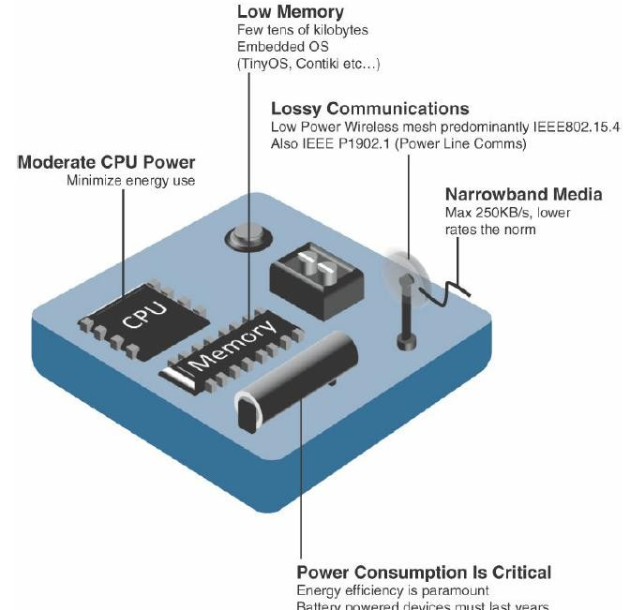
Module 2: Smart Objects: The “Things” in IOT
Design Constraints for Wireless Smart objects

Slide 40
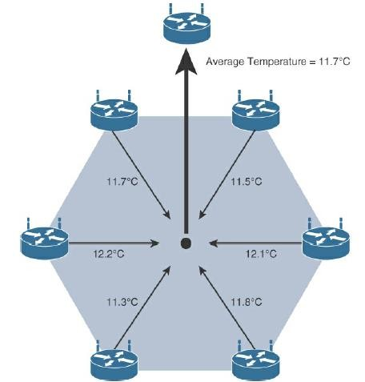
Module 2: Smart Objects: The “Things” in IOT
Data Aggregation in Wireless Sensor Networks Smart Objects

Slide 41
Module 2: Smart Objects: The “Things” in IOT
Sensor Networks:
The data aggregation techniques are helpful in reducing the amount of overall traffic (and energy) in WSNs with very large numbers of deployed smart objects.
This data aggregation at the network edges is where fog and mist computing are critical IoT architectural elements needed to deliver the scale and performance required by so many IoT use cases.
Wirelessly connected smart objects generally have one of the following two communication patterns:
Event-driven:
Transmission of sensory information is triggered only when a smart object detects a particular event or predetermined threshold.
Periodic:
Transmission of sensory information occurs only at periodic intervals.

Slide 42
Module 2: Smart Objects: The “Things” in IOT
Connecting Smart Objects:
“Communications Criteria,” describes the characteristics and attributes should be considered when selecting and dealing with connecting smart objects
The various technologies used for connecting sensors can differ greatly depending on the criteria used to analyze them.
Range
Frequency Bands
Power Consumption
Topology
Constrained Devices
Constrained-Node Networks

Slide 43
Module 2: Smart Objects: The “Things” in IOT
Communications Criteria:
Range:
How far does the signal need to be propagated?
what will be the area of coverage for a selected wireless technology?
Should indoor versus outdoor deployments be differentiated?
Short range:
The classical wired example is a serial cable.
Wireless short-range technologies are often considered as an alternative to a serial cable, supporting tens of meters of maximum distance between two devices.
Examples of short-range wireless technologies are IEEE 802.15.1 Bluetooth and IEEE 802.15.7 Visible Light Communications(VLC).

Slide 44
Module 2: Smart Objects: The “Things” in IOT
Communications Criteria:
2. Medium range:
This range is the main category of IoT access technologies.
In the range of tens to hundreds of meters, many specifications and implementations are available.
The maximum distance is generally less than 1 mile between two devices, although RF technologies do not have real maximum distances defined, as long as the radio signal is transmitted and received in the scope of the applicable specification.
Examples of medium-range wireless technologies include IEEE 802.11 Wi-Fi, IEEE 802.15.4, and 802.15.4g WPAN.
Wired technologies such as IEEE 802.3 Ethernet and IEEE 1901.2 Narrowband Power Line Communications (PLC) may also be classified as medium range, depending on their physical media characteristics.

Slide 45
Module 2: Smart Objects: The “Things” in IOT
Communications Criteria:
3. Long range:
Distances greater than 1 mile between two devices require long-range technologies.
Wireless examples are cellular (2G, 3G, 4G) and some applications of outdoor IEEE 802.11 Wi-Fi and Low-Power Wide-Area (LPWA) technologies.
LPWA communications have the ability to communicate over a large area without consuming much power.
These technologies are therefore ideal for battery-powered IoT sensors.
IEEE 802.3 over optical fiber and IEEE 1901 Broadband Power Line Communications are classified as long range

Slide 46
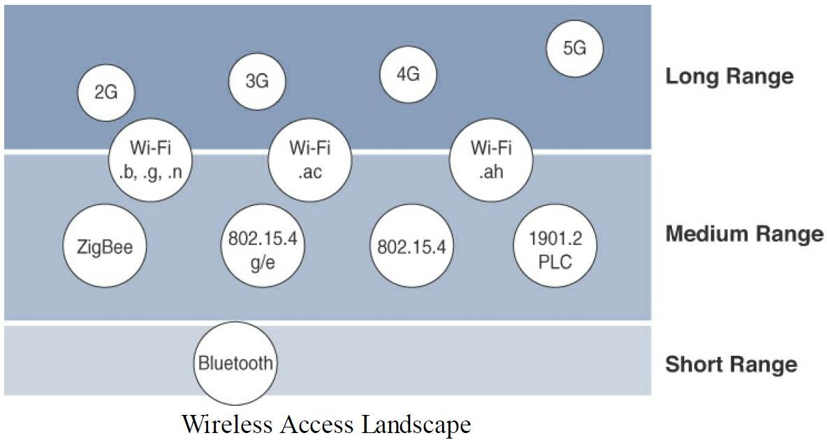
Module 2: Smart Objects: The “Things” in IOT
Communications Criteria:

Slide 47
Module 2: Smart Objects: The “Things” in IOT
Communications Criteria:
2. Frequency Bands:
Radio spectrum is regulated by countries and/or organizations, such as the International Telecommunication Union (ITU) and the Federal Communications Commission (FCC).
These groups define the regulations and transmission requirements for various frequency bands.
For example, portions of the spectrum are allocated to types of telecommunications such as radio, television, military, and so on.
On IoT access technologies, the frequency bands leveraged by wireless communications are split between licensed and unlicensed bands.
Licensed spectrum is generally applicable to IoT long-range access technologies and allocated to communications infrastructures deployed by services providers, public services (for example, first responders, military), broadcasters, and utilities.

Slide 48
Module 2: Smart Objects: The “Things” in IOT
Communications Criteria:
2. Frequency Bands:
Examples of licensed spectrum commonly used for IoT access are cellular, WiMAX, and Narrowband IoT (NB-IoT) technologies.
The ITU has also defined unlicensed spectrum for the industrial, scientific, and medical (ISM) portions of the radio bands for short-range devices (SRDs).
Unlicensed means that no guarantees or protections are offered in the ISM bands for device communications.
For IoT access, these are the most well-known ISM bands:
2.4 GHz band as used by IEEE 802.11b/g/n Wi-Fi
IEEE 802.15.1 Bluetooth
IEEE 802.15.4 WPAN(Wireless Personal Area Network).

Slide 49
Module 2: Smart Objects: The “Things” in IOT
Communications Criteria:
2. Frequency Bands:
The frequency of transmission directly impacts how a signal propagates and its practical maximum range.
Some communications within the ISM bands operate in the sub-GHz range.
Sub-GHz bands are used by protocols such as IEEE 802.15.4, 802.15.4g, and 802.11ah, and LPWA technologies such as LoRa and Sigfox.
Either for indoor or outdoor deployments, the sub-GHz frequency bands allow greater distances between devices.
These bands have a better ability than the 2.4 GHz ISM band to penetrate building infrastructures or go around obstacles, while keeping the transmit power within regulation.

Slide 50
Module 2: Smart Objects: The “Things” in IOT
Communications Criteria:
2. Frequency Bands:
The disadvantage of sub-GHz frequency bands is their lower rate of data delivery compared to higher frequencies.
Most IoT sensors do not need to send data at high rates.
Therefore, the lower transmission speeds of sub-GHz technologies are usually not a concern for IoT sensor deployments.
For example, in most European countries, the 169 MHz band is often considered best suited for wireless water and gas metering applications.
This is due to its good deep building basement signal penetration, the low data rate of this frequency matches the low volume of data that needs to be transmitted.

Slide 51
Module 2: Smart Objects: The “Things” in IOT
Communications Criteria:
2. Frequency Bands:
Several sub-GHz ranges have been defined in the ISM band.
The most well known ranges are centered on 169 MHz, 433 MHz, 868 MHz, and 915 MHz.
Most IoT access technologies tend to focus on the two sub-GHz frequency regions around 868 MHz and 915 MHz.
These main bands are commonly found throughout the world and are applicable to nearly all countries.
The European Conference of Postal and Telecommunications Administrations (CEPT), in the European Radio communications Committee (ERC)Recommendation 70-03, defines the 868 MHz frequency band.
CEPT was established in 1959 as a coordinating body for European state telecommunications and postal organizations.

Slide 52
Module 2: Smart Objects: The “Things” in IOT
Communications Criteria:
3. Power Consumption:
Powered nodes and battery-powered nodes.
A powered node has a direct connection to a power source, and communications are usually not limited by power consumption criteria.
Ease of deployment of powered nodes is limited by the availability of a power source, which makes mobility more complex.
Battery-powered nodes bring much more flexibility to IoT devices.
These nodes are often classified by the required lifetimes of their batteries.
For devices under regular maintenance, a battery life of 2 to 3 years is an option.
IoT wireless access technologies must address the needs of low power consumption and connectivity for battery-powered nodes.

Slide 53
Module 2: Smart Objects: The “Things” in IOT
Communications Criteria:
3. Power Consumption:
This has led to the evolution of a new wireless environment known as Low-Power Wide-Area (LPWA).
It is possible to run just about any wireless technology on batteries.
However, in reality, no operational deployment will be acceptable if hundreds of batteries must be changed every month.

Slide 54
Module 2: Smart Objects: The “Things” in IOT
Communications Criteria:
4. Topology
Among the access technologies available for connecting IoT devices, three main topology schemes are dominant: star, mesh, and peer-to-peer.
For long range and short-range technologies, a star topology is prevalent, as seen with cellular, LPWA, and Bluetooth networks.
Star topologies utilize a single central base station or controller to allow communications with endpoints.
For medium-range technologies, a star, peer-to-peer, or mesh topology is common.
Peer-to-peer topologies allow any device to communicate with any other device as long as they are in range of each other.

Slide 55
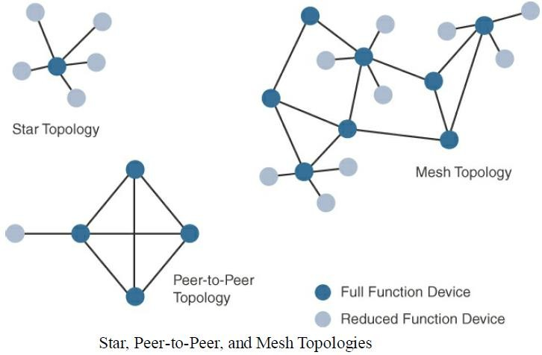
Module 2: Smart Objects: The “Things” in IOT
Communications Criteria:
4. Topology
Obviously, peer-to-peer topologies rely on multiple full-function devices.
Peer-to-peer topologies enable more complex formations, such as a mesh networking topology.

Slide 56
Module 2: Smart Objects: The “Things” in IOT
Communications Criteria:
4. Topology
For example,
Indoor Wi-Fi deployments are mostly a set of nodes forming a star topology around their access points (APs).
Meanwhile,
outdoor Wi-Fi may consist of a mesh topology for the backbone of APs, with nodes connecting to the APs in a star topology.
Similarly, IEEE 802.15.4 and 802.15.4g and even wired IEEE 1901.2a PLC are generally deployed as a mesh topology.

Slide 57
Module 2: Smart Objects: The “Things” in IOT
Communications Criteria:
4. Topology
A mesh topology helps cope with low transmit power, searching to reach a greater overall distance, and coverage by having intermediate nodes relaying traffic for other nodes.
Mesh topology requires the implementation of a Layer 2 forwarding protocol known as mesh-under or a Layer 3 forwarding protocol referred to as mesh over on each intermediate node.
An intermediate node or full-function device (FFD) is simply a node that interconnects other nodes.
A node that doesn’t interconnect or relay the traffic of other nodes is known as a leaf node, or reduced-function device (RFD).

Slide 58
Module 2: Smart Objects: The “Things” in IOT
Communications Criteria:
5. Constrained Devices:
The Internet Engineering Task Force (IETF) acknowledges in RFC 7228 that different categories of IoT devices are deployed.
While categorizing the class of IoT nodes is a perilous exercise, with computing, memory, storage, power, and networking continuously evolving and improving, RFC 7228 gives some definitions of constrained nodes.
These definitions help differentiate constrained nodes from unconstrained nodes, such as servers, desktop or laptop computers, and powerful mobile devices such as smart phones.
Constrained nodes have limited resources that impact their networking feature set and capabilities.

Slide 59
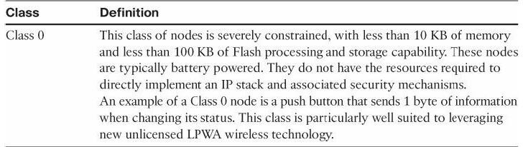
Module 2: Smart Objects: The “Things” in IOT
Communications Criteria:
5. Constrained Devices:
some classes of IoT nodes do not implement an IP stack.
According to RFC 7228, constrained nodes can be broken down into the classes

Slide 60
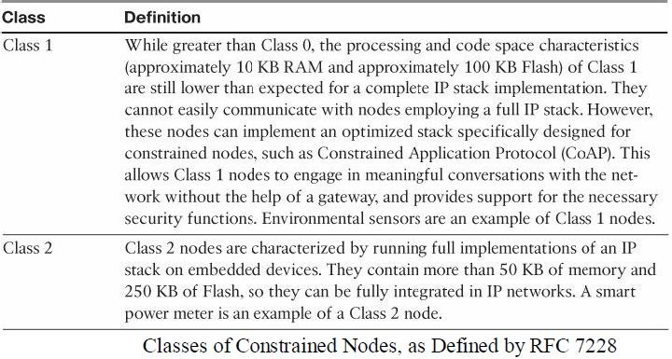
Module 2: Smart Objects: The “Things” in IOT
Communications Criteria:
5. Constrained Devices:

Slide 61
Module 2: Smart Objects: The “Things” in IOT
Communications Criteria:
6. Constrained-Node Networks:
While several of the IoT access technologies, such as Wi-Fi and cellular, are applicable to laptops, smart phones, and some IoT devices, some IoT access technologies are more suited to specifically connect constrained nodes.
Typical examples are IEEE 802.15.4 and 802.15.4g RF, IEEE 1901.2a PLC, LPWA, and IEEE 802.11ah access technologies.
Constrained-node networks are often referred to as low-power and lossy networks (LLNs).
Low-power in the context of LLNs refers to the fact that nodes must cope with the requirements from powered and battery-powered constrained nodes.

Slide 62
Module 2: Smart Objects: The “Things” in IOT
Communications Criteria:
6. Constrained-Node Networks:
Lossy networks indicates that network performance may suffer from interference and variability due to harsh radio environments.
Layer 1 and Layer 2 protocols that can be used for constrained-node networks must be evaluated in the context of the following characteristics for use-case applicability: data rate and throughput, latency and determinism, and overhead and payload.

Slide 63
Module 2: Smart Objects: The “Things” in IOT
Communications Criteria:
6. Constrained-Node Networks:
Data Rate and Throughput:
The data rates available from IoT access technologies range from 100 bps with protocols such as Sigfox to tens of megabits per second with technologies such as LTE and IEEE 802.11ac.
Technologies not particularly designed for IoT, such as cellular and Wi-Fi, match up well to IoT applications with high bandwidth requirements.
Nodes involved with video analytics have a need for high data rates.
These nodes are found in retail, airport, and smart cities environments for detecting events and driving actions.

Slide 64
Module 2: Smart Objects: The “Things” in IOT
Communications Criteria:
6. Constrained-Node Networks:
Data Rate and Throughput:
Short-range technologies can also provide medium to high data rates that have enough throughput to connect a few endpoints.
For example, Bluetooth sensors that are now appearing on connected wearables fall into this category.

Slide 65
Module 2: Smart Objects: The “Things” in IOT
Communications Criteria:
6. Constrained-Node Networks:
Latency and Determinism:
Latency expectations of IoT applications should be known when selecting an access technology.
This is particularly true for wireless networks, where packet loss and retransmissions due to interference, collisions, and noise are normal behaviors.
On constrained networks, latency may range from a few milliseconds to seconds, and applications and protocol stacks must cope with these wide ranging values.

Slide 66
Module 2: Smart Objects: The “Things” in IOT
Communications Criteria:
6. Constrained-Node Networks:
Overhead and Payload:
The minimum IPv6 MTU( maximum transmission unit ) size is expected to be 1280 bytes.
Therefore, the fragmentation of the IPv6 payload has to be taken into account by link layer access protocols with smaller MTUs.
For example, the payload size for IEEE 802.15.4 is 127 bytes and requires an IPv6 payload
with a minimum MTU of 1280 bytes to be fragmented.

Slide 67
Module 2: Smart Objects: The “Things” in IOT
IoT Access Technologies:
Topics that are addressed for each IoT access technology:
Standardization and alliances: The standards bodies that maintain the protocols for a technology.
Physical layer: The wired or wireless methods and relevant frequencies
MAC layer: Considerations at the Media Access Control (MAC) layer, which bridges the physical layer with data link control
Topology: The topologies supported by the technology
Security: Security aspects of the technology
Competitive technologies: Other technologies that are similar.

Slide 68
Module 2: Smart Objects: The “Things” in IOT
IoT Access Technologies:
IEEE 802.15.4
IEEE 802.15.4 is a wireless access technology for low-cost and low-data-rate devices that are powered or run on batteries.
This access technology enables easy installation using a compact protocol stack while remaining both simple and flexible.

Slide 69
Module 2: Smart Objects: The “Things” in IOT
IoT Access Technologies:
Standardization and Alliances
IEEE 802.15.4 or IEEE 802.15 Task Group 4 defines low-data-rate PHY and MAC layer specifications for wireless personal area networks (WPAN).
This standard has solution for low complexity wireless devices with low data rates that need many months or even years of battery life.
Since 2003, the IEEE has published several iterations of the IEEE 802.15.4 specification, each labeled with the publication’s year.
For example, IEEE 802.15.4-2003 was published in 2003, 802.15.4-2006 was released in 2006, and 802.15.4-2011 and 802.15.4-2015 were issued in 2011 and 2015, respectively.

Slide 70
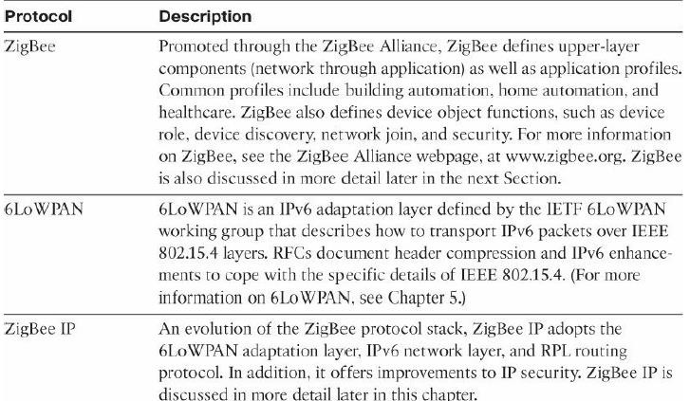
Module 2: Smart Objects: The “Things” in IOT
IoT Access Technologies:

Slide 71
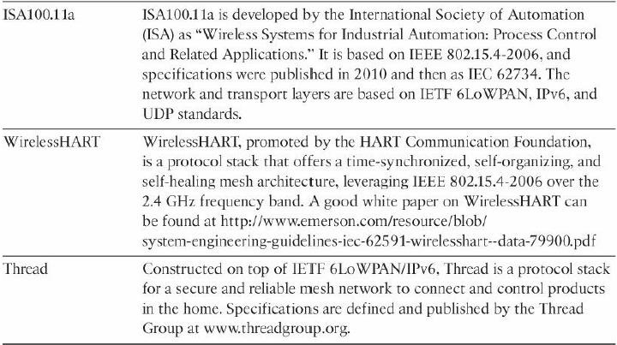
Module 2: Smart Objects: The “Things” in IOT
IoT Access Technologies:

Slide 72
Module 2: Smart Objects: The “Things” in IOT
IoT Access Technologies: IEEE 802.15.4
ZigBee:
Based on the idea of ZigBee-style networks in the late 1990s, the first ZigBee specification was ratified in 2004, shortly after the release of the IEEE 802.15.4 specification the previous year.
Industry support has grown to more than 400 companies that are members of the ZigBee
Alliance.
Similar to the Wi-Fi Alliance, the Zigbee Alliance is an industry group formed to certify interoperability between vendors and it is committed to driving and evolving ZigBee as an IoT solution for interconnecting smart objects.

Slide 73
Module 2: Smart Objects: The “Things” in IOT
IoT Access Technologies: IEEE 802.15.4
ZigBee:
ZigBee solutions are aimed at smart objects and sensors that have low bandwidth and low power needs.
products that are ZigBee compliant and certified by the ZigBee Alliance should interoperate even though different vendors may manufacture them.
In the 2006 revision, sets of commands and message types were introduced, and increased in number in the 2007 (called Zigbee pro) iteration, to achieve different functions for a device, such as metering, temperature, or lighting control.
These sets of commands and message types are called clusters.

Slide 74
Module 2: Smart Objects: The “Things” in IOT
IoT Access Technologies: IEEE 802.15.4
ZigBee:
For home automation, ZigBee can control lighting, thermostats, and security functions.
ZigBee Smart Energy brings together a variety of interoperable products, such as smart meters, that can monitor and control the use and delivery of utilities, such as electricity and water.
These ZigBee products are controlled by the utility provider and can help coordinate usage between homes and businesses and the utility provider itself to provide more efficient operations.
ZigBee utilizes the IEEE 802.15.4 standard at the lower PHY and MAC layers.
ZigBee specifies the network and security layer and application support layer that sit on top of the lower layers.
The ZigBee network and security layer provides mechanisms for network startup, configuration, routing, and securing communications.

Slide 75
Module 2: Smart Objects: The “Things” in IOT
IoT Access Technologies: IEEE 802.15.4
ZigBee:
This includes calculating routing paths in what is often a changing topology, discovering neighbors, and managing the routing tables as devices join for the first time.
The network layer is also responsible for forming the appropriate topology, which is often a mesh but could be a star or tree as well.
From a security perspective, ZigBee utilizes 802.15.4 for security at the MAC layer, using the Advanced Encryption Standard (AES) with a 128-bit key and also provides security at the network and application layers.
The application support layer interfaces the lower portion of the stack dealing with the networking of ZigBee devices with the higher-layer applications.

Slide 76
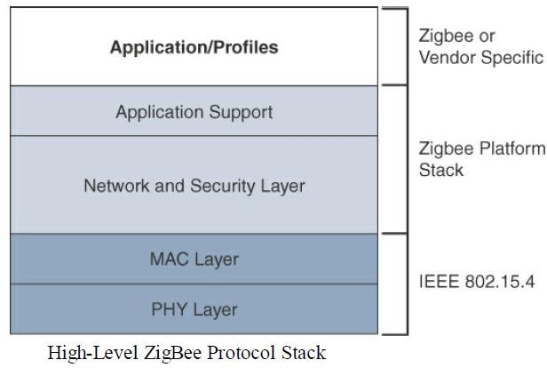
Module 2: Smart Objects: The “Things” in IOT
IoT Access Technologies: IEEE 802.15.4
ZigBee:

Slide 77
Module 2: Smart Objects: The “Things” in IOT
IoT Access Technologies: IEEE 802.15.4
ZigBee IP:
With the introduction of ZigBee IP, the support of IEEE 802.15.4 continues, but the IP and TCP/UDP protocols and various other open standards are now supported at the network and transport layers.
The ZigBee-specific layers are now found only at the top of the protocol stack for the applications.
ZigBee IP was created to embrace the open standards coming from the IETF’s work on LLNs, such as IPv6, 6LoWPAN, and RPL.
They provide for low-bandwidth, low-power, and cost-effective communications when
connecting smart objects.
ZigBee IP is a critical part of the Smart Energy (SE) Profile 2.0 specification from the ZigBee Alliance. SE 2.0 is aimed at smart metering and residential energy management systems.
In fact, ZigBee IP was designed specifically for SE 2.0 but it is not limited to this use case.

Slide 78
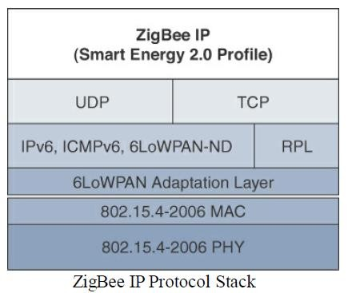
Module 2: Smart Objects: The “Things” in IOT
IoT Access Technologies: IEEE 802.15.4
ZigBee IP:

Slide 79
Module 2: Smart Objects: The “Things” in IOT
IoT Access Technologies: IEEE 802.15.4
ZigBee IP:
ZigBee IP supports 6LoWPAN as an adaptation layer
The 6LoWPAN mesh addressing header is not required as ZigBee IP utilizes the mesh-over or route-over method for forwarding packets.
ZigBee IP requires the support of 6LoWPAN’s fragmentation and header compression schemes.
At the network layer, all ZigBee IP nodes support IPv6, ICMPv6, and 6LoWPAN Neighbor Discovery (ND), and utilize RPL for the routing of packets across the mesh network.

Slide 80
Module 2: Smart Objects: The “Things” in IOT
IoT Access Technologies: IEEE 802.15.4
Physical Layer:
The 802.15.4 standard supports an extensive number of PHY options that range from 2.4 GHz to sub-GHz frequencies in ISM bands.
The original IEEE 802.15.4-2003 standard specified only three PHY options based on direct sequence spread spectrum (DSSS) modulation.
DSSS is a modulation technique in which a signal is intentionally spread in the frequency domain, resulting in greater bandwidth.
The original physical layer transmission options were as follows:
2.4 GHz, 16 channels, with a data rate of 250 kbps
915 MHz, 10 channels, with a data rate of 40 kbps
868 MHz, 1 channel, with a data rate of 20 kbps
Only the 2.4 GHz band operates worldwide.

Slide 81
Module 2: Smart Objects: The “Things” in IOT
IoT Access Technologies: IEEE 802.15.4
Physical Layer:
IEEE 802.15.4-2006, 802.15.4-2011, and IEEE 802.15.4-2015 introduced additional PHY communication options, including the following:
OQPSK PHY:
This is DSSS PHY, employing offset quadrature phaseshift keying (OQPSK) modulation.
OQPSK is a modulation technique that uses four unique bit values that are signaled by phase changes.
An offset function that is present during phase shifts allows data to be transmitted more reliably.

Slide 82
Module 2: Smart Objects: The “Things” in IOT
IoT Access Technologies: IEEE 802.15.4
Physical Layer:
BPSK PHY:
This is DSSS PHY, employing binary phase-shift keying (BPSK) modulation.
BPSK specifies two unique phase shifts as its data encoding scheme.
ASK PHY:
This is parallel sequence spread spectrum (PSSS) PHY, employing amplitude shift keying (ASK) and BPSK modulation.
PSSS is an advanced encoding scheme that offers increased range, throughput, data rates, and signal integrity compared to DSSS. ASK uses amplitude shifts instead of phase shifts to signal different bit values.

Slide 83
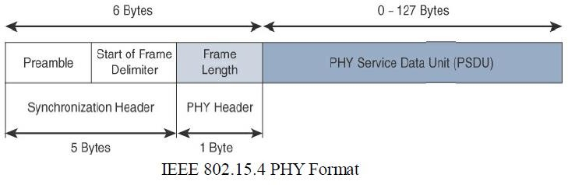
Module 2: Smart Objects: The “Things” in IOT
IoT Access Technologies: IEEE 802.15.4
Physical Layer:

Slide 84
Module 2: Smart Objects: The “Things” in IOT
IoT Access Technologies: IEEE 802.15.4
Physical Layer:
The synchronization header for this frame is composed of the Preamble and the Start of Frame Delimiter fields.
The Preamble field is a 32-bit 4-byte (for parallel construction) pattern that identifies the start of the frame and is used to synchronize the data transmission.
The Start of Frame Delimiter field informs the receiver that frame contents start immediately after this byte.
The PHY Header portion of the PHY frame shown in Figure is simply a frame length value.
It lets the receiver know how much total data to expect in the PHY service data unit (PSDU) portion of the 802.4.15 PHY.
The PSDU is the data field or payload.

Slide 85
Module 2: Smart Objects: The “Things” in IOT
IoT Access Technologies: IEEE 802.15.4
MAC Layer:
The IEEE 802.15.4 MAC layer manages access to the PHY channel by defining how devices in the same area will share the frequencies allocated.
The 802.15.4 MAC layer performs the following tasks:
Network beaconing for devices acting as coordinators (New devices use beacons to join an 802.15.4 network)
PAN association and disassociation by a device
Device security
Reliable link communications between two peer MAC entities

Slide 86
Module 2: Smart Objects: The “Things” in IOT
IoT Access Technologies: IEEE 802.15.4
MAC Layer:
The MAC layer achieves these tasks by using our types of MAC frames are specified in 802.15.4:
Data frame: Handles all transfers of data
Beacon frame: Used in the transmission of beacons from a PAN coordinator
Acknowledgement frame: Confirms the successful reception of a frame
MAC command frame: Responsible for control communication between devices

Slide 87
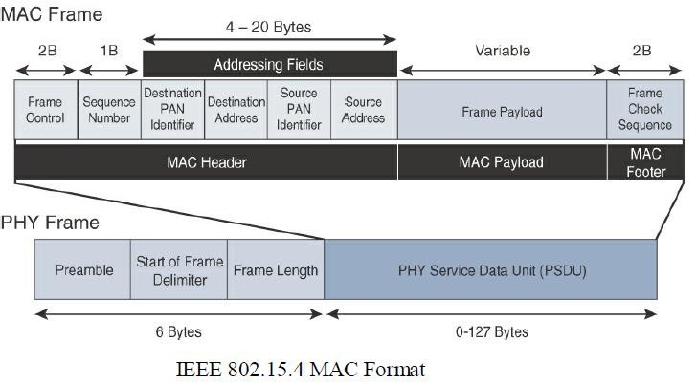
Module 2: Smart Objects: The “Things” in IOT
IoT Access Technologies: IEEE 802.15.4
MAC Layer:
Notice that the MAC frame is carried as the PHY payload.
The 802.15.4 MAC frame can be broken down into the MAC Header, MAC Payload, and MAC Footer fields.

Slide 88
Module 2: Smart Objects: The “Things” in IOT
IoT Access Technologies: IEEE 802.15.4
MAC Layer:
The MAC Header field is composed of the Frame Control, Sequence Number and the Addressing fields.
The Frame Control field defines attributes such as frame type, addressing modes, and other control flags.
The Sequence Number field indicates the sequence identifier for the frame.
The Addressing field specifies the Source and Destination PAN Identifier fields as well as the Source and Destination Address fields.
The MAC Payload field varies by individual frame type.
For example, beacon frames have specific fields and payloads related to beacons, while MAC command frames have different fields present.
The MAC Footer field is nothing more than a frame check sequence (FCS).
An FCS is a calculation based on the data in the frame that is used by the receiving side to confirm the integrity of the data in the frame.

Slide 89
Module 2: Smart Objects: The “Things” in IOT
IoT Access Technologies: IEEE 802.15.4
Topology:
IEEE 802.15.4–based networks can be built as star, peer-to-peer, or mesh topologies.
Mesh networks tie together many nodes.
This allows nodes that would be out of range if trying to communicate directly to leverage intermediary nodes to transfer communications.
Every 802.15.4 PAN should be set up with a unique ID.
All the nodes in the same 802.15.4 network should use the same PAN ID.

Slide 90
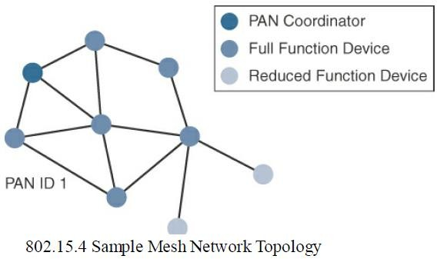
Module 2: Smart Objects: The “Things” in IOT
IoT Access Technologies: IEEE 802.15.4
Topology:

Slide 91
Module 2: Smart Objects: The “Things” in IOT
IoT Access Technologies: IEEE 802.15.4
Topology:
Full-function devices (FFDs) and reduced-function devices (RFDs) are defined in IEEE 802.15.4.
A minimum of one FFD acting as a PAN coordinator is required to deliver services that allow other devices to associate and form a cell or PAN.
Notice in Figure that a single PAN coordinator is identified for PAN ID 1.
FFD devices can communicate with any other devices, whereas RFD devices can communicate only with FFD devices.

Slide 92
Module 2: Smart Objects: The “Things” in IOT
IoT Access Technologies: IEEE 802.15.4
Security:
The IEEE 802.15.4 specification uses Advanced Encryption Standard (AES) with a 128 bit key length as the base encryption algorithm for securing its data.
Established by the US National Institute of Standards and Technology in 2001, AES is a block cipher, which means it operates on fixed-size blocks of data.
The use of AES by the US government and its widespread adoption in the private sector has helped it become one of the most popular algorithms used in symmetric key cryptography.
In addition to encrypting the data, AES in 802.15.4 also validates the data that is sent.
This is accomplished by a message integrity code (MIC), which is calculated for the entire frame using the same AES key that is used for encryption.

Slide 93
Module 2: Smart Objects: The “Things” in IOT
IoT Access Technologies: IEEE 802.15.4
Security:
Enabling these security features for 802.15.4 changes the frame format slightly and consumes some of the payload.
Using the Security Enabled field in the Frame Control portion of the 802.15.4 header is the first step to enabling AES encryption.
This Security Enabled field is a single bit that is set to 1 for security.
Once this bit is set, a field called the Auxiliary Security Header is created after the Source Address field, by stealing some bytes from the Payload field.
Next Figure shows the IEEE 802.15.4 frame format at a high level, with the Security Enabled bit set and the Auxiliary Security Header field present.

Slide 94
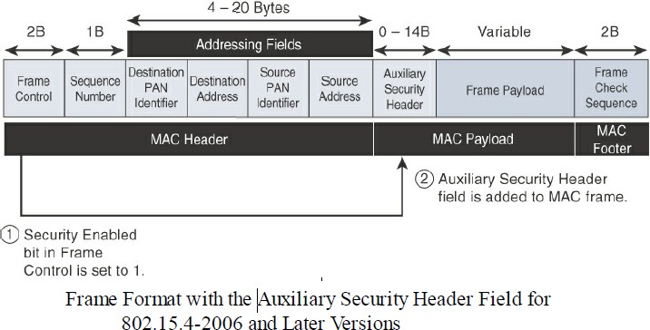
Module 2: Smart Objects: The “Things” in IOT
IoT Access Technologies: IEEE 802.15.4
Security:

Slide 95
Module 2: Smart Objects: The “Things” in IOT
IoT Access Technologies: IEEE 802.15.4
Competitive Technologies:
The IEEE 802.15.4 PHY and MAC layers are the foundations for several networking profiles that compete against each other in various IoT access environments.
These various vendors and organizations build upper-layer protocol stacks on top of an 802.15.4 core.
A competitive radio technology that is different in its PHY and MAC layers is DASH7.
DASH7 was originally based on the ISO18000-7 standard and positioned for industrial communications, whereas IEEE 802.15.4 is more generic.

Slide 96
Module 2: Smart Objects: The “Things” in IOT
IoT Access Technologies: IEEE 802.15.4
Competitive Technologies:
Commonly employed in active radio frequency identification (RFID) implementations, DASH7 was used by US military forces for many years, mainly for logistics purposes.
Active RFID utilizes radio waves generated by a battery-powered tag on an object to enable continuous tracking.
The current DASH7 technology offers low power consumption, a compact protocol stack, range up to 1 mile, and AES encryption.
Frequencies of 433 MHz, 868 MHz, and 915 MHz have been defined, enabling data rates up to 166.667 kbps and a maximum payload of 256 bytes.

Slide 97
Module 2: Smart Objects: The “Things” in IOT
IoT Access Technologies: IEEE 802.15.4
IEEE 802.15.4 Conclusions:
The IEEE 802.15.4 wireless PHY and MAC layers are mature specifications that are the foundation for various industry standards and products
The PHY layer offers a maximum speed of up to 250 kbps, but this varies based on modulation and frequency.
The MAC layer for 802.15.4 is robust and handles how data is transmitted and received over the PHY layer.
Specifically, the MAC layer handles the association and disassociation of devices to/from a PAN, reliable communications between devices, security, and the formation of various topologies.
The topologies used in 802.15.4 include star, peer-to-peer, and cluster trees that allow for the formation of mesh networks.

Slide 98
Module 2: Smart Objects: The “Things” in IOT
IoT Access Technologies: IEEE 802.15.4
IEEE 802.15.4 Conclusions:
From a security perspective, 802.15.4 utilizes AES encryption to allow secure communications and also provide data integrity. The main competitor to IEEE 802.15.4 is DASH7, another wireless technology
IEEE 802.15.4 has an edge in the marketplace through all the different vendors and organizations that utilize its PHY and MAC layers.
For IoT sensor deployments requiring low power, low data rate, and low complexity, the IEEE 802.15.4 standard deserves strong consideration.

Slide 99
Module 2: Smart Objects: The “Things” in IOT
IoT Access Technologies: IEEE 802.15.4g and 802.15.4e
The IEEE 802.15.4e amendment of 802.15.4-2011 expands the MAC layer feature set to remedy the disadvantages associated with 802.15.4, including MAC reliability, unbounded latency, and multipath fading.
In addition to making general enhancements to the MAC layer, IEEE 802.15.4e also made improvements to better cope with certain application domains, such as factory and process automation and smart grid.
Smart grid is associated with the modernization of the power grid and utilities infrastructure by connecting intelligent devices and communications.
IEEE 802.15.4e-2012 enhanced the IEEE 802.15.4 MAC layer capabilities in the areas of frame format ,security determinism mechanism and frequency hopping.

Slide 100
Module 2: Smart Objects: The “Things” in IOT
IoT Access Technologies: IEEE 802.15.4g and 802.15.4e
802.15.4g seeks to optimize large outdoor wireless mesh networks for field area networks (FANs).
New PHY definitions are introduced, as well as some MAC modifications needed to support their implementation.

Slide 101
Module 2: Smart Objects: The “Things” in IOT
IoT Access Technologies: IEEE 802.15.4g and 802.15.4e
This technology applies to IoT use cases such as :
Distribution automation and industrial supervisory control and data acquisition (SCADA) environments for remote monitoring and control .
Public lighting
Environmental wireless sensors in smart cities
Electrical vehicle charging stations
Smart parking meters
Microgrids
Renewable energy

Slide 102
Module 2: Smart Objects: The “Things” in IOT
IoT Access Technologies: IEEE 802.15.4g and 802.15.4e
Standardization and Alliances
Because 802.15.4g-2012 and 802.15.4e-2012 are simply amendments to IEEE 802.15.4-2011, the same IEEE 802.15 Task Group 4 standards body authors, maintains, and integrates them into the next release of the core specification.
The additional capabilities and options provided by 802.15.4g-2012 and 802.15.4e-2012 led to additional difficulty in achieving the interoperability between devices and mixed vendors that users requested.
To guarantee interoperability, the Wi-SUN Alliance was formed. (SUN stands for smart utility network.)
This organization is not a standards body but is instead an industry alliance that defines communication profiles for smart utility and related networks.
These profiles are based on open standards, such as 802.15.4g-2012, 802.15.4e-2012, IPv6, 6LoWPAN, and UDP for the FAN profile.

Slide 103
Module 2: Smart Objects: The “Things” in IOT
IoT Access Technologies: IEEE 802.15.4g and 802.15.4e
Physical Layer:
In IEEE 802.15.4g-2012, the original IEEE 802.15.4 maximum PSDU or payload size of 127 bytes was increased for the SUN PHY to 2047 bytes.
This provides a better match for the greater packet sizes found in many upper-layer protocols.
For example, the default IPv6 MTU setting is 1280 bytes.
Fragmentation is no longer necessary at Layer 2 when IPv6 packets are transmitted over IEEE 802.15.4g MAC frames.
The error protection was improved in IEEE 802.15.4g by evolving the CRC from 16 to 32 bits.
The SUN PHY, as described in IEEE 802.15.4g-2012, supports multiple data rates in bands ranging from 169 MHz to 2.4 GHz.
These bands are covered in the unlicensed ISM frequency spectrum specified by various countries and regions.

Slide 104
Module 2: Smart Objects: The “Things” in IOT
IoT Access Technologies: IEEE 802.15.4g and 802.15.4e
Within these bands, data must be modulated onto the frequency using at least one of the following PHY mechanisms to be IEEE 802.15.4g compliant:
Multi-Rate and Multi-Regional Frequency Shift Keying (MR-FSK):
Offers good transmit power efficiency due to the constant envelope of the transmit signal
Multi-Rate and Multi-Regional Orthogonal Frequency Division Multiplexing (MR-OFDM):
Provides higher data rates but may be too complex for low-cost and low-power devices
Multi-Rate and Multi-Regional Offset Quadrature Phase-Shift Keying (MR-O-QPSK):
Shares the same characteristics of the IEEE 802.15.4-2006 O-QPSK PHY, making multi-mode systems more cost effective and easier to design.

Slide 105
Module 2: Smart Objects: The “Things” in IOT
IoT Access Technologies: IEEE 802.15.4g and 802.15.4e
MAC Layer:
While the IEEE 802.15.4e-2012 amendment is not applicable to the PHY layer, it is pertinent to the MAC layer.
This amendment enhances the MAC layer through various functions, which may be selectively enabled based on various implementations of the standard.

Slide 106
Module 2: Smart Objects: The “Things” in IOT
IoT Access Technologies: IEEE 802.15.4g and 802.15.4e
MAC Layer:
The following are some of the main enhancements to the MAC layer proposed by IEEE 802.15.4e-2012:
1. Time-Slotted Channel Hopping (TSCH):
TSCH is an IEEE 802.15.4e- 2012 MAC operation mode that works to guarantee media access and channel diversity.
Channel hopping, also known as frequency hopping, utilizes different channels for transmission at different times.
TSCH divides time into fixed time periods, or “time slots,” which offer guaranteed bandwidth and Predictable latency.

Slide 107
Module 2: Smart Objects: The “Things” in IOT
IoT Access Technologies: IEEE 802.15.4g and 802.15.4e
MAC Layer:
1. Time-Slotted Channel Hopping (TSCH):
In a time slot, one packet and its acknowledgement can be transmitted, increasing network capacity because multiple nodes can communicate in the same time slot, using different channels.
A number of time slots are defined as a “slot frame,” which is regularly repeated to provide “guaranteed access.”
The transmitter and receiver agree on the channels and the timing for switching between channels through the combination of a global time slot counter and a global channel hopping sequence list, as computed on each node to determine the channel of each time slot.
TSCH adds robustness in noisy environments and smoother coexistence with other wireless technologies ,especially for industrial use cases.

Slide 108
Module 2: Smart Objects: The “Things” in IOT
IoT Access Technologies: IEEE 802.15.4g and 802.15.4e
MAC Layer:
2. Information elements:
Information elements (IEs) allow for the exchange of information at the MAC layer in an extensible manner, either as header IEs (standardized) and/or payload IEs (private).
Specified in a tag, length, value (TLV) format, the IE field allows frames to carry additional metadata to support MAC layer services.
These services may include IEEE 802.15.9 key management, Wi-SUN 1.0 IEs to broadcast and unicast schedule timing information, and frequency hopping synchronization information for the 6TiSCH architecture.

Slide 109
Module 2: Smart Objects: The “Things” in IOT
IoT Access Technologies: IEEE 802.15.4g and 802.15.4e
MAC Layer:
3. Enhanced beacons (EBs):
EBs extend the flexibility of IEEE 802.15.4 beacons to allow the construction of application-specific beacon content.
This is accomplished by including relevant IEs in EB frames.
Some IEs that may be found in EBs include network metrics, frequency hopping broadcast schedule, and PAN information version.

Slide 110
Module 2: Smart Objects: The “Things” in IOT
IoT Access Technologies: IEEE 802.15.4g and 802.15.4e
MAC Layer:
4. Enhanced beacon requests (EBRs):
Like enhanced beacons, an enhanced beacon request (EBRs) also leverages IEs.
The IEs in EBRs allow the sender to selectively specify the request of information.
For example, a device can query for a PAN that is allowing new devices to join or a PAN that supports a certain set of MAC/PHY capabilities.

Slide 111
Module 2: Smart Objects: The “Things” in IOT
IoT Access Technologies: IEEE 802.15.4g and 802.15.4e
MAC Layer:
5. Enhanced Acknowledgement:
The Enhanced Acknowledgement frame allows for the integration of a frame counter for the frame being acknowledged.
This feature helps protect against certain attacks that occur when Acknowledgement frames are spoofed.

Slide 112
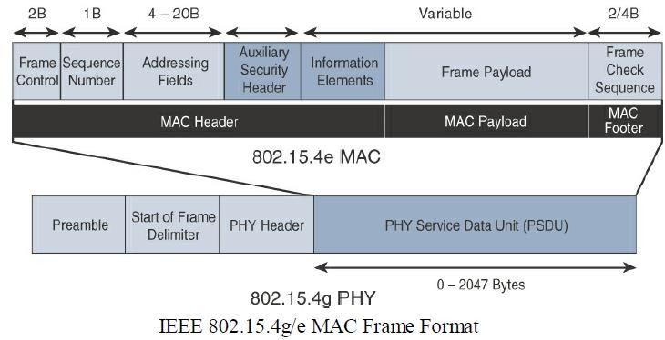
Module 2: Smart Objects: The “Things” in IOT
IoT Access Technologies: IEEE 802.15.4g and 802.15.4e
MAC Layer:

Slide 113
Module 2: Smart Objects: The “Things” in IOT
IoT Access Technologies: IEEE 802.15.4g and 802.15.4e
MAC Layer:
The 802.15.4e MAC is similar to the 802.15.4 MAC
The main changes shown in the IEEE 802.15.4e header are the presence of the Auxiliary Security Header and Information Elements field.
The Auxiliary Security header provides for the encryption of the data frame.
This field is optionally supported in both 802.15.4e-2012 and 802.15.4, starting with the 802.15.4-2006 specification.
The IE field contains one or more information elements that allow for additional information to be exchanged at the MAC layer.

Slide 114
Module 2: Smart Objects: The “Things” in IOT
IoT Access Technologies: IEEE 802.15.4g and 802.15.4e
TOPOLOGY
Deployments of IEEE 802.15.4g-2012 are mostly based on a mesh topology.
Because a mesh topology is typically the best choice for use cases in the industrial and smart cities areas where 802.15.4g-2012 is applied.
A mesh topology allows deployments to be done in urban or rural areas, expanding the distance between nodes that can relay the traffic of other nodes.
Support for battery-powered nodes with a long lifecycle requires optimized Layer 2 forwarding or Layer 3 routing protocol implementations.
This provides an extra level of complexity but is necessary in order to cope with sleeping battery-powered nodes.

Slide 115
Module 2: Smart Objects: The “Things” in IOT
IoT Access Technologies: IEEE 802.15.4g and 802.15.4e
Security:
Both IEEE 802.15.4g and 802.15.4e inherit their security attributes from the IEEE 802.15.4-2006 specification.
Encryption is provided by AES, with a 128-bit key.
In addition to the Auxiliary Security Header field initially defined in 802.15.4-2006, a secure acknowledgement and a secure Enhanced Beacon field complete the MAC layer security.

Slide 116
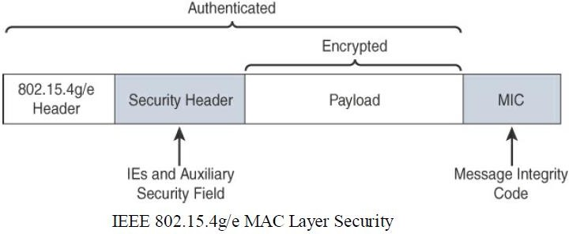
Module 2: Smart Objects: The “Things” in IOT
IoT Access Technologies: IEEE 802.15.4g and 802.15.4e
Security:

Slide 117
Module 2: Smart Objects: The “Things” in IOT
IoT Access Technologies: IEEE 802.15.4g and 802.15.4e
Security:
The full frame gets authenticated from the MIC at the end of frame.
The MIC is a unique value that is calculated based on the contents of the frame.
The Security Header field is composed of the Auxiliary Security field and one or more Information Elements fields.
Integration of the Information Elements fields allows for the adoption of additional security capabilities, such as the IEEE 802.15.9 Key Management Protocol (KMP) specification.
KMP provides a means for establishing keys for robust datagram security.

Slide 118
Module 2: Smart Objects: The “Things” in IOT
IoT Access Technologies: IEEE 802.15.4g and 802.15.4e
Competitive Technologies:
Competitive technologies to IEEE 802.15.4g and 802.15.4e parallel the technologies that also compete with IEEE 802.15.4, such as DASH7.
IEEE 802.15.4 is well established and already deployed in many scenarios, mostly indoors.

Slide 119
Module 2: Smart Objects: The “Things” in IOT
IoT Access Technologies: IEEE 802.15.4g and 802.15.4e
IEEE 802.15.4g and 802.15.4e Conclusions:
IEEE 802.15.4g and 802.15.4e are simply amendments to the IEEE 802.15.4 standard.
They are mature specifications that are integrated into IEEE 802.15.4-2015.
They have been successfully deployed in real-world scenarios, and already support millions of endpoints.
IEEE 802.15.4g focuses mainly on improvements to the PHY layer, while IEEE 802.15.4e targets the MAC layer.

Slide 120
Module 2: Smart Objects: The “Things” in IOT
IoT Access Technologies: IEEE 802.15.4g and 802.15.4e
IEEE 802.15.4g and 802.15.4e Conclusions:
These improvements overcome many of the disadvantages of IEEE 802.15.4, such as latency and vulnerability to multipath fading.
The Wi-SUN Alliance is an important industry alliance that provides interoperability and certification for industry implementations.
Utilizing 802.15.4g as a foundation, the alliance releases profiles, such as the FAN profile, to help promote the adoption of the technology while guaranteeing interoperability between vendors.

Slide 121
Module 2: Smart Objects: The “Things” in IOT
IoT Access Technologies: IEEE 802.15.4g and 802.15.4e
IEEE 802.15.4g and 802.15.4e Conclusions:
These improvements overcome many of the disadvantages of IEEE 802.15.4, such as latency and vulnerability to multipath fading.
The Wi-SUN Alliance is an important industry alliance that provides interoperability and certification for industry implementations.
Utilizing 802.15.4g as a foundation, the alliance releases profiles, such as the FAN profile, to help promote the adoption of the technology while guaranteeing interoperability between vendors.

Slide 122
Module 2: Smart Objects: The “Things” in IOT
IoT Access Technologies
IEEE 1901.2a
While most of the constrained network technologies relate to wireless, IEEE 1901.2a-2013 is a wired technology that is an update to the original IEEE 1901.2 specification.
This is a standard for Narrowband Power Line Communication (NB-PLC).
NB-PLC leverages a narrow band spectrum for low power, long range, and resistance to interference over the same wires that carry electric power.

Slide 123
Module 2: Smart Objects: The “Things” in IOT
IoT Access Technologies: IEEE 1901.2a
NB-PLC is often found in use cases such as the following:
Smart metering:
NB-PLC can be used to automate the reading of utility meters, such as electric, gas, and water meters.
This is true particularly in Europe, where PLC is the preferred technology for utilities deploying smart meter solutions.
Distribution automation:
NB-PLC can be used for distribution automation, which involves monitoring and controlling all the devices in the power grid.

Slide 124
Module 2: Smart Objects: The “Things” in IOT
IoT Access Technologies: IEEE 1901.2a
NB-PLC is often found in use cases such as the following:
Public lighting:
A common use for NB-PLC is with public lighting—the lights found in cities and along streets, highways, and public areas such as parks.
Electric vehicle charging stations:
NB-PLC can be used for electric vehicle charging stations, where the batteries of electric vehicles can be recharged.

Slide 125
Module 2: Smart Objects: The “Things” in IOT
IoT Access Technologies: IEEE 1901.2a
NB-PLC is often found in use cases such as the following:
Microgrids:
NB-PLC can be used for microgrids, local energy grids that can disconnect from the traditional grid and operate independently.
Renewable energy:
NB-PLC can be used in renewable energy applications, such as solar, wind power, hydroelectric, and geothermal heat.

Slide 126
Module 2: Smart Objects: The “Things” in IOT
IoT Access Technologies: IEEE 1901.2a
Physical Layer:
NB-PLC is defined for frequency bands from 3 to 500 kHz.
The IEEE 1901.2 working group has integrated support for all world regions in order to develop a worldwide standard.
Specifications include support for CENELEC A and B bands, US FCC-Low and FCC-above-CENELEC, and Japan ARIB bands.
CENELEC is the French Comité Européen de Normalisation Électrotechnique, which in English translates to European Committee for Electrotechnical Standardization.
This organization is responsible for standardization in the area of electrical engineering for Europe.
The CENELEC A and B bands refer to 9–95 kHz and 95–125 kHz, respectively.

Slide 127
Module 2: Smart Objects: The “Things” in IOT
IoT Access Technologies: IEEE 1901.2a
Physical Layer:
The FCC is the Federal Communications Commission, a US government organization that regulates interstate and international communications by radio, television, wire, satellite, and cable.
The FCC-Low band encompasses 37.5–117.1875 kHz, and the FCC-above-CENELEC band is 154.6875–487.5 kHz.
The FCC-above-CENELEC band may become the most useful frequency due to its higher throughput and reduced interference.

Slide 128
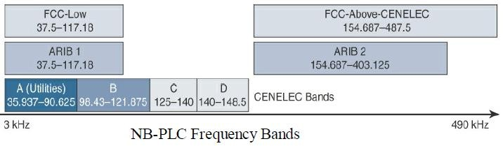
Module 2: Smart Objects: The “Things” in IOT
IoT Access Technologies: IEEE 1901.2a
Physical Layer:
Figure shows the various frequency bands for NB-PLC. most well-known bands are regulated by CENELEC and the FCC, but the Japan Association of Radio Industries and Businesses (ARIB) band is also present. The two ARIB frequency bands are ARIB 1, 37.5–117.1875 kHz, and ARIB 2, 154.6875–403.125 kHz.

Slide 129
Module 2: Smart Objects: The “Things” in IOT
IoT Access Technologies: IEEE 1901.2a
Physical Layer:
IEEE 1901.2a supports the largest set of coding and enables both robustness and throughput.
The standard includes tone maps and modulations, such as robust modulation (ROBO), differential binary phase shift keying (DBPSK), differential quadrature phase shift keying (DQPSK), differential 8-point phase shift keying (D8PSK) for all bands, and optionally 16 quadrature amplitude modulation (16QAM) for some bands.
ROBO mode transmits redundant information on multiple carriers, and DBPSK, DQPSK, and D8PSK are all variations of phase shift keying, where the phase of a signal is changed to signal a binary data transmission.
ROBO utilizes QPSK modulation, and its throughput depends on the degree to which coding is repeated across streams.
For example, standard ROBO uses a repetition of 4, and Super-ROBO utilizes a repetition of 6.

Slide 130
Module 2: Smart Objects: The “Things” in IOT
IoT Access Technologies: IEEE 1901.2a
Physical Layer:
One major difference between IEEE 802.15.4g/e and IEEE 1901.2a is the full integration of different types of modulation and tone maps by a single PHY layer in the IEEE 1901.2a specification.
The PHY payload size can change dynamically, based on channel conditions in IEEE 1901.2a.
Therefore, MAC sublayer segmentation is implemented. If the size of the MAC payload is too large to fit within one PHY service data unit (PSDU), the MAC payload is partitioned into smaller segments.
MAC payload segmentation is done by dividing the MAC payload into multiple smaller amounts of data (segments), based on PSDU size.
The segmentation may require the addition of padding bytes to the last payload segment so that the final MPDU fills the PSDU.
All forms of addressing (unicast and broadcast) are subject to segmentation.

Slide 131
Module 2: Smart Objects: The “Things” in IOT
IoT Access Technologies: IEEE 1901.2a
MAC Layer
The MAC frame format of IEEE 1901.2a is based on the IEEE 802.15.4 MAC frame but integrates the latest IEEE 802.15.4e-2012 amendment, which enables key features to be supported.
One of the key components brought from 802.15.4e to IEEE 1901.2a is information elements.
With IE support, additional capabilities, such as IEEE 802.15.9 Key Management Protocol and SSID, are supported.
Figure provides an overview of the general MAC frame format for IEEE 1901.2.
Note that the numeric value above each field in the frame shows the size of the field, in bytes.

Slide 132
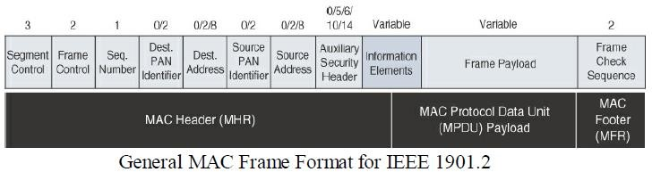
Module 2: Smart Objects: The “Things” in IOT
IoT Access Technologies: IEEE 1901.2a
MAC Layer

Slide 133
Module 2: Smart Objects: The “Things” in IOT
IoT Access Technologies: IEEE 1901.2a
MAC Layer
IEEE 1901.2 has a Segment Control field.
This is a new field that was not present in MAC frame for 802.15.4 and 802.15.4e.
This field handles the segmentation or fragmentation of upper-layer packets with sizes larger than what can be carried in the MAC protocol data unit (MPDU).

Slide 134
Module 2: Smart Objects: The “Things” in IOT
IoT Access Technologies: IEEE 1901.2a
Topology
Use cases and deployment topologies for IEEE 1901.2a are tied to the physical power lines.
As with wireless technologies, signal propagation is limited by factors such as noise, interference, distortion, and attenuation.
These factors become more prevalent with distance, so most NB-PLC deployments use some sort of mesh topology.
Mesh networks offer the advantage of devices relaying the traffic of other devices so longer distances can be segmented.

Slide 135
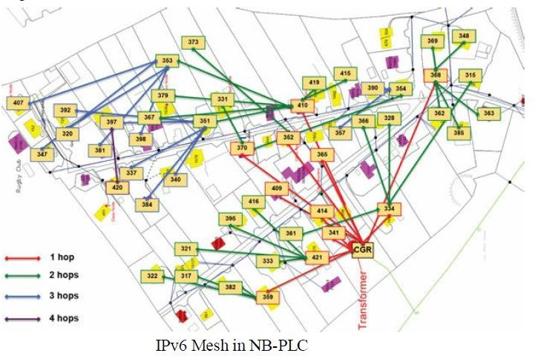
Module 2: Smart Objects: The “Things” in IOT
IoT Access Technologies: IEEE 1901.2a
Topology
Figure highlights a network scenario in which a PLC mesh network is applied to a neighborhood.

Slide 136
Module 2: Smart Objects: The “Things” in IOT
IoT Access Technologies: IEEE 1901.2a
Security
IEEE 1901.2a security offers similar features to IEEE 802.15.4g.
Encryption and authentication are performed using AES.
In addition, IEEE 1901.2a aligns with 802.15.4g in its ability to support the IEEE 802.15.9 Key Management Protocol.

Slide 137
Module 2: Smart Objects: The “Things” in IOT
IoT Access Technologies: IEEE 1901.2a
Security
The differences are mostly tied to the PHY layer fragmentation capabilities of IEEE 1901.2a and include the following:
The Security Enabled bit in the Frame Control field should be set in all MAC frames carrying segments of an encrypted frame.
If data encryption is required, it should be done before packet segmentation.
During packet encryption, the Segment Control field should not be included in the input to the encryption algorithm.

Slide 138
Module 2: Smart Objects: The “Things” in IOT
IoT Access Technologies: IEEE 1901.2a
Security
On the receiver side, the data decryption is done after packet reassembly.
When security is enabled, the MAC payload is composed of the ciphered payload and the message integrity code (MIC) authentication tag for non-segmented payloads.
If the payload is segmented, the MIC is part of the last packet (segment) only.
The MIC authentication is computed using only information from the MHR of the frame carrying the first segment.

Slide 139
Module 2: Smart Objects: The “Things” in IOT
IoT Access Technologies: IEEE 1901.2a
Competitive Technologies:
In the domain of NB-PLC, two technologies compete against IEEE 1901.2a: G3-PLC (now ITU G.9903) and PRIME (now ITU G.9904).
Both of these technologies were initially developed to address a single use case: Smart metering deployment in Europe over the CENELEC A band.

Slide 140
Module 2: Smart Objects: The “Things” in IOT
IoT Access Technologies: IEEE 1901.2a
IEEE 1901.2a Conclusions
IEEE 1901.2a is an open PHY and MAC standard approach to enable the use of Narrowband Power Line Communication.
The set of use cases for this standard depends on and also benefits from the physical power lines that interconnect the devices.
The IEEE 1901.2a standard leverages the earlier standards G3-PLC (now ITU G.9903) and PRIME (now ITU G.9904).

Slide 141
Module 2: Smart Objects: The “Things” in IOT
IoT Access Technologies: IEEE 802.11ah
Wi-Fi lacks sub-GHz support for better signal penetration, low power for battery-powered nodes, and the ability to support a large number of devices.
For these reasons, the IEEE 802.11 working group launched a task group named IEEE 802.11ah to specify a sub-GHz version of Wi-Fi.

Slide 142
Module 2: Smart Objects: The “Things” in IOT
IoT Access Technologies: IEEE 802.11ah
Three main use cases are identified for IEEE 802.11ah:
Sensors and meters covering a smart grid:
Meter to pole, environmental/agricultural monitoring, industrial process sensors, indoor healthcare system and fitness sensors, home and building automation sensors
Backhaul aggregation of industrial sensors and meter data:
Potentially connecting IEEE 802.15.4g subnetworks
Extended range Wi-Fi:
For outdoor extended-range hotspot or cellular traffic offloading.

Slide 143
Module 2: Smart Objects: The “Things” in IOT
IoT Access Technologies: IEEE 802.11ah
Standardization and Alliances:
In July 2010, the IEEE 802.11 working group worked on an “industrial Wi-Fi” and created the IEEE 802.11ah group.
The 802.11ah specification would operate in unlicensed sub-GHz frequency bands, similar to IEEE 802.15.4 and other LPWA technologies.
The industry organization that promotes Wi-Fi certifications and interoperability for 2.4 GHz and 5 GHz products is the Wi-Fi Alliance.
The Wi-Fi Alliance is a similar body to the Wi-SUN Alliance.
For the 802.11ah standard, the Wi-Fi Alliance defined a new brand called Wi-Fi HaLow.

Slide 144
Module 2: Smart Objects: The “Things” in IOT
IoT Access Technologies: IEEE 802.11ah
Physical Layer:
IEEE 802.11ah essentially provides an additional 802.11 physical layer operating in unlicensed sub-GHz bands.
For example, various countries and regions use the following bands for IEEE 802.11ah: 868–868.6 MHz for EMEAR, 902–928 MHz and associated subsets for North America and Asia- Pacific regions, and 314–316 MHz, 430–434 MHz, 470–510 MHz, and 779– 787 MHz for China.

Slide 145
Module 2: Smart Objects: The “Things” in IOT
IoT Access Technologies: IEEE 802.11ah
MAC Layer:
The IEEE 802.11ah MAC layer is optimized to support the new sub-GHz Wi-Fi PHY while providing low power consumption and the ability to support a larger number of endpoints.
Enhancements and features specified by IEEE 802.11ah for the MAC layer include the following:
Number of devices: Has been scaled up to 8192 per access point.
MAC header: Has been shortened to allow more efficient communication.
Null data packet (NDP) support: Is extended to cover several control and management frames.
Relevant the control information is concentrated in the PHY header and the additional overhead associated with decoding the MAC header and data payload is avoided.
This change makes l frame exchanges efficient and less power-consuming for the receiving stations.
Grouping and sectorization: Enables an AP to use sector antennas and also group stations (distributing a group ID).
In combination with RAW and TWT, this mechanism reduces contention in large cells with many clients by restricting which group, in which sector, can content during with time window.

Slide 146
Module 2: Smart Objects: The “Things” in IOT
IoT Access Technologies: IEEE 802.11ah
MAC Layer:
Restricted access window (RAW): Is a control algorithm that avoids simultaneous transmissions when many devices are present and provides fair access to the wireless network.
By providing more efficient access to the medium, additional power savings for battery-powered devices can be achieved, and collisions are reduced.
Target wake time (TWT): Reduces energy consumption by permitting an access point to define times when a device can access the network.
This allows devices to enter a low-power state until their TWT time arrives.
It also reduces the probability of collisions in large with many clients .
7. Speed frame exchange:
Enables an AP and endpoint to exchange frames during a reserved transmit opportunity (TXOP).
This reduces contention on the medium, minimizes the number of frame exchanges to improve channel efficiency, and extends battery life by keeping awake times short.

Slide 147
Module 2: Smart Objects: The “Things” in IOT
IoT Access Technologies: IEEE 802.11ah
Topology:
While IEEE 802.11ah is deployed as a star topology, it includes a simple hops relay operation to extend its range.
It allows one 802.11ah device to act as an intermediary and relay data to another.
This relay operation can be combined with a higher transmission rate or modulation and coding scheme (MCS).
This means that a higher transmit rate is used by relay devices talking directly to the access point.

Slide 148
Module 2: Smart Objects: The “Things” in IOT
IoT Access Technologies: IEEE 802.11ah
Topology:
Sectorization is a technique that involves partitioning the coverage area into several sectors to get reduced contention within a certain sector.
This technique is useful for limiting collisions in cells that have many clients.
This technique is also often necessary when the coverage area of 802.11ah access points is large, and interference from neighboring access points is problematic.
Sectorization uses an antenna array and beam-forming techniques to partition the cell-coverage area.

Slide 149
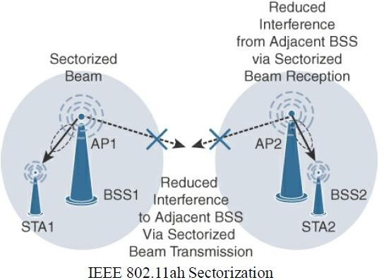
Module 2: Smart Objects: The “Things” in IOT
IoT Access Technologies: IEEE 802.11ah
Topology:

Slide 150
Module 2: Smart Objects: The “Things” in IOT
IoT Access Technologies: IEEE 802.11ah
Security:
No additional security has been identified for IEEE 802.11ah compared to other IEEE 802.11 specifications.
These protocols include IEEE 802.15.4, IEEE 802.15.4e, and IEEE 1901.2a, and the security information for them is also applicable to IEEE 802.11ah.

Slide 151
Module 2: Smart Objects: The “Things” in IOT
IoT Access Technologies: IEEE 802.11ah
Competitive Technologies:
Competitive technologies to IEEE 802.11ah are IEEE 802.15.4 and IEEE 802.15.4e, along with the competitive technologies highlighted in each of their sections.

Slide 152
Module 2: Smart Objects: The “Things” in IOT
IoT Access Technologies: IEEE 802.11ah
IEEE 802.11ah Conclusions:
The IEEE 802.11ah access technology is an ongoing effort of the IEEE 802.11 working group to define an “industrial Wi-Fi.”
Currently, this standard is just at the beginning of its evolution.
This specification offers a longer range than traditional Wi-Fi technologies and provides good support for low-power devices that need to send smaller bursts of data at lower speeds.

Slide 153
Module 2: Smart Objects: The “Things” in IOT
IoT Access Technologies:
LoRaWAN:
It is a new set of wireless technologies known as Low-Power Wide-Area (LPWA).
Particularly well adapted for long-range and battery-powered endpoints, LPWA technologies open new business opportunities to both services providers and enterprises considering IoT solutions.

Slide 154
Module 2: Smart Objects: The “Things” in IOT
IoT Access Technologies: LoRaWAN:
Standardization and Alliances:
Initially, LoRa was a physical layer, or Layer 1, modulation that was developed by a French company named Cycleo.
Later, Cycleo was acquired by Semtech.
Optimized for long-range, two-way communications and low power consumption, the technology evolved from Layer 1 to a broader scope through the creation of the LoRa Alliance.
Semtech LoRa as a Layer 1 PHY modulation technology is available through multiple chipset vendors

Slide 155
Module 2: Smart Objects: The “Things” in IOT
IoT Access Technologies: LoRaWAN:
Standardization and Alliances:
To differentiate from the physical layer modulation known as LoRa, the LoRa Alliance uses the term LoRaWAN to refer to its architecture and its specifications that describe end-to-end LoRaWAN communications and protocols.
Next Figure provides a high-level overview of the LoRaWAN layers.
In this figure, notice that Semtech is responsible for the PHY layer, while the LoRa Alliance handles the MAC layer and regional frequency bands

Slide 156
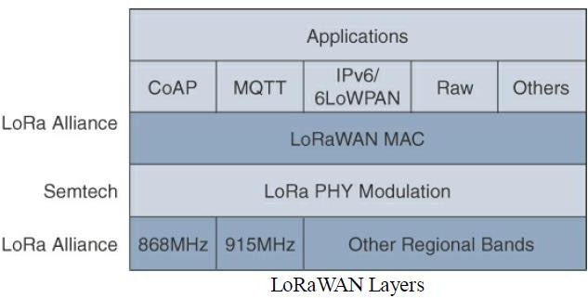
Module 2: Smart Objects: The “Things” in IOT
IoT Access Technologies: LoRaWAN:
Standardization and Alliances:

Slide 157
Module 2: Smart Objects: The “Things” in IOT
IoT Access Technologies: LoRaWAN:
Physical Layer:
Semtech LoRa modulation is based on chirp spread spectrum modulation, which trades a lower data rate for receiver sensitivity to significantly increase the communication distance.
In addition, it allows demodulation below the noise floor, offers robustness to noise and interference, and manages a single channel occupation by different spreading factors.
This enables LoRa devices to receive on multiple channels in parallel.
LoRaWAN 1.0.2 regional specifications describe the use of the main unlicensed sub-GHz frequency bands of 433 MHz, 779–787 MHz, 863–870 MHz, and 902–928 MHz, as well as regional profiles for a subset of the 902 -928 MHZ bandwidth.

Slide 158
Module 2: Smart Objects: The “Things” in IOT
IoT Access Technologies: LoRaWAN:
Physical Layer:
LoRa gateway is deployed as the center hub of a star network architecture.
It uses multiple transceivers and channels and can demodulate multiple channels at once or even demodulate multiple signals on the same channel simultaneously.
LoRa gateways serve as a transparent bridge relaying data between endpoints, and the endpoints use a single-hop wireless connection to communicate with one or many gateways.
The data rate in LoRaWAN varies depending on the frequency bands and adaptive data rate (ADR).

Slide 159
Module 2: Smart Objects: The “Things” in IOT
IoT Access Technologies: LoRaWAN:
Physical Layer:
ADR is an algorithm that manages the data rate and radio signal for each endpoint.
The ADR algorithm ensures that packets are delivered at the best data rate possible and that network performance is both optimal and scalable.
Endpoints close to the gateways with good signal values transmit with the highest data rate, which enables a shorter transmission time over the wireless network, and the lowest transmit power.
Meanwhile, endpoints at the edge of the link budget communicate at the lowest data rate and highest transmit power.

Slide 160
Module 2: Smart Objects: The “Things” in IOT
IoT Access Technologies: LoRaWAN:
MAC Layer:
MAC layer is defined in the LoRaWAN specification.
This layer takes advantage of the LoRa physical layer and classifies LoRaWAN endpoints to optimize their battery life and ensure downstream communications to the LoRaWAN endpoints.

Slide 161
Module 2: Smart Objects: The “Things” in IOT
IoT Access Technologies: LoRaWAN:
MAC Layer:
The LoRaWAN specification documents three classes of LoRaWAN devices:
Class A:
This class is the default implementation.
Optimized for battery powered nodes, it allows bidirectional communications, where a given node is able to receive downstream traffic after transmitting.
Two receive windows are available after each transmission.

Slide 162
Module 2: Smart Objects: The “Things” in IOT
IoT Access Technologies: LoRaWAN:
MAC Layer:
Class B:
This class was designated “experimental” in LoRaWAN 1.0.1 until it can be better defined.
A Class B node or endpoint should get additional receive windows compared to Class A, but gateways must be synchronized through a beaconing process.
Class C:
This class is particularly adapted for powered nodes.
This classification enables a node to be continuously listening by keeping its receive window open when not transmitting.

Slide 163
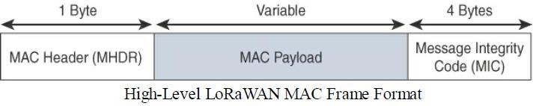
Module 2: Smart Objects: The “Things” in IOT
IoT Access Technologies: LoRaWAN:
MAC Layer:
LoRaWAN messages, either uplink or downlink, have a PHY payload composed of a 1-byte MAC header, a variable-byte MAC payload, and a MIC that is 4 bytes in length.
The MAC payload size depends on the frequency band and the data rate, ranging from 59 to 230 bytes for the 863–870 MHz band and 19 to 250 bytes for the 902–928 MHz band.

Slide 164
Module 2: Smart Objects: The “Things” in IOT
IoT Access Technologies: LoRaWAN:
MAC Layer:
In version 1.0.x, LoRaWAN utilizes six MAC message types.
LoRaWAN devices use join request and join accept messages for over-the-air (OTA) activation and joining the network.
The other message types are unconfirmed data up/down and confirmed data up/down.
A “confirmed” message is one that must be acknowledged, and “unconfirmed” signifies that the end device does not need to acknowledge.
Uplink messages are sent from endpoints to the network server and are relayed by one.

Slide 165
Module 2: Smart Objects: The “Things” in IOT
IoT Access Technologies: LoRaWAN:
MAC Layer:
Downlink messages flow from the network server to a single endpoint and are relayed by only a single gateway.
LoRaWAN endpoints are uniquely addressable through a variety of methods, including the following:
An endpoint can have a global end device ID or DevEUI represented as an IEEE EUI-64 address.
An endpoint can have a global application ID or AppEUI represented as an IEEE EUI-64 address that uniquely identifies the application provider such as the owner, of the end device.

Slide 166
Module 2: Smart Objects: The “Things” in IOT
IoT Access Technologies: LoRaWAN:
MAC Layer:
In a LoRaWAN network, endpoints are also known by their end device address, known as a DevAddr, a 32-bit address.
The 7 most significant bits are the network identifier (NwkID), which identifies the LoRaWAN network.
The 25 least significant bits are used as the network address (NwkAddr) to identify the endpoint in the network.

Slide 167
Module 2: Smart Objects: The “Things” in IOT
IoT Access Technologies: LoRaWAN:
Topology:
LoRaWAN topology is often described as a “star of stars” topology.
The infrastructure consists of endpoints exchanging packets through gateways acting as bridges, with a central LoRaWAN network server.
Gateways connect to the backend network using standard IP connections, and endpoints communicate directly with one or more gateways.

Slide 168
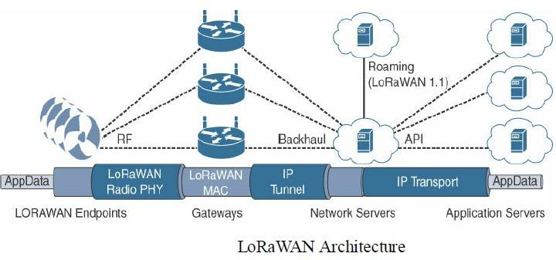
Module 2: Smart Objects: The “Things” in IOT
IoT Access Technologies: LoRaWAN:
Topology:

Slide 169
Module 2: Smart Objects: The “Things” in IOT
IoT Access Technologies: LoRaWAN:
Topology:
LoRaWAN endpoints transport their selected application data over the LoRaWAN MAC layer on top of one of the supported PHY layer frequency bands.
The application data is contained in upper protocol layers.
These upper layers could be raw data on top of the LoRaWAN MAC layer, or the data could be stacked in multiple protocols.
For example, it has upper-layer protocols, such as ZigBee Control Layer (ZCL), Constrained Application Protocol (CoAP), or Message Queuing Telemetry Transport (MQTT), with or without an IPv6/6LoWPAN layer.

Slide 170
Module 2: Smart Objects: The “Things” in IOT
IoT Access Technologies: LoRaWAN:
Topology:
Figure also shows how LoRaWAN gateways act as bridges that relay between endpoints and the network servers. Multiple gateways can receive and transport the same packets.
When duplicate packets are received, deduplication is a function of the network server.
The LoRaWAN network server manages the data rate and radio frequency (RF) of each endpoint through the adaptive data rate (ADR) algorithm.
ADR is a key component of the network scalability, performance, and battery life of the endpoints.
The LoRaWAN network server forwards the application data to application servers.

Slide 171
Module 2: Smart Objects: The “Things” in IOT
IoT Access Technologies: LoRaWAN:
Security:
Security in a LoRaWAN deployment applies to different components of the architecture.
LoRaWAN endpoints must implement two layers of security, protecting communications and data privacy across the network.
The first layer, called “network security” but applied at the MAC layer, guarantees the authentication of the endpoints by the LoRaWAN network server.
Also, it protects LoRaWAN packets by performing encryption based on AES.

Slide 172
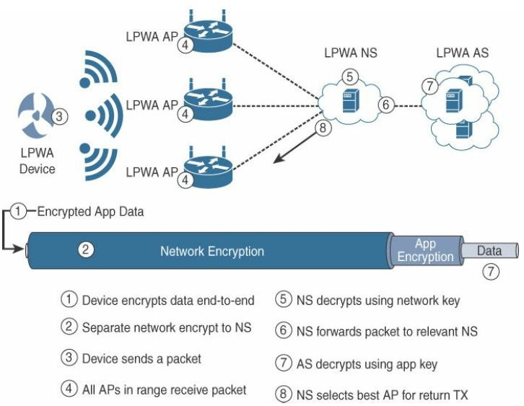
Module 2: Smart Objects: The “Things” in IOT
IoT Access Technologies: LoRaWAN:
Security:

Slide 173
Module 2: Smart Objects: The “Things” in IOT
IoT Access Technologies: LoRaWAN:
Security:
Each endpoint implements a network session key (NwkSKey), used by both itself and the LoRaWAN network server.
The NwkSKey ensures data integrity through computing and checking the MIC of every data message as well as encrypting and decrypting MAC-only data message payloads.
The second layer is an application session key (AppSKey), which performs encryption and decryption functions between the endpoint and its application server.
Endpoints receive their AES-128 application key (AppKey) from the application owner.
This key is derived from an application specific root key exclusively known to and under the control of the application provider.

Slide 174
Module 2: Smart Objects: The “Things” in IOT
IoT Access Technologies: LoRaWAN:
Security:
LoRaWAN endpoints attached to a LoRaWAN network must get registered and authenticated. This can be achieved through one of the two join mechanisms:
Activation by personalization (ABP):
Endpoints don’t need to run a join procedure as their individual details, including DevAddr and the NwkSKey and AppSKey session keys, are preconfigured and stored in the end device.
This same information is registered in the LoRaWAN network server.

Slide 175
Module 2: Smart Objects: The “Things” in IOT
IoT Access Technologies: LoRaWAN:
Security:
Over-the-air activation (OTAA):
Endpoints are allowed to dynamically join a particular LoRaWAN network after successfully going through a join procedure.
The join procedure must be done every time a session context is renewed.
During the join process, which involves the sending and receiving of MAC layer join request and join accept messages, the node establishes its credentials with a LoRaWAN network server, exchanging its globally unique DevEUI, AppEUI, and AppKey.
The AppKey is then used to derive the session NwkSKey and AppSKey keys.

Slide 176
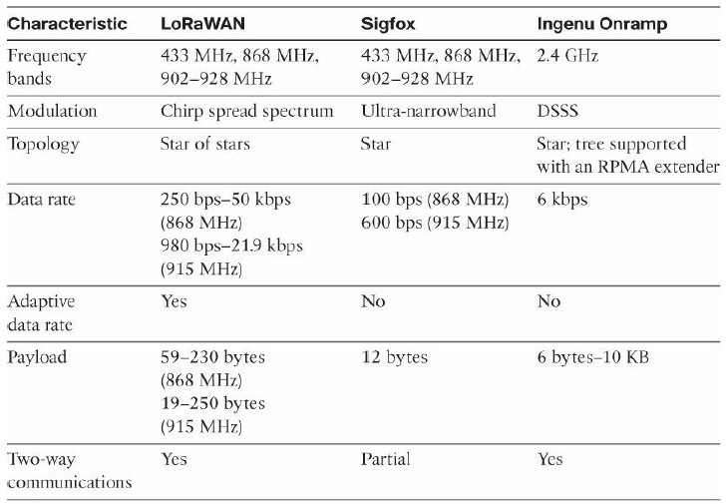
Module 2: Smart Objects: The “Things” in IOT
IoT Access Technologies: LoRaWAN:
Competitive Technologies:

Slide 177
Module 2: Smart Objects: The “Things” in IOT
IoT Access Technologies: LoRaWAN:
LoRaWAN Conclusions:
The LoRaWAN wireless technology was developed for LPWANs that are critical for implementing many new devices on IoT networks.
The term LoRa refers to the PHY layer, and LoRaWAN focuses on the architecture, the MAC layer, and a unified, single standard for seamless interoperability.
LoRaWAN is managed by the LoRa Alliance, an industry organization.
The PHY and MAC layers allow LoRaWAN to cover longer distances with a data rate that can change depending on various factors.
The LoRaWAN architecture depends on gateways to bridge endpoints to network servers.
From a security perspective, LoRaWAN offers AES authentication and encryption at two separate layers.

